Slide 1
VSU Data Science Bootcamp
Day 1
Introduction to Claims Data

Slide 2
Conceptual Framework for Data Science
Damman, 2019
Online Journal of Public
Health Informatics
Data
Numbers, symbols, text, images, recordings
Organized & “Cleaned” Data in Context
Information
Useful, summarized information; compared with standard/reference
i.e. “Biostatistical Analysis”
Data collection, processing, management & storage (Biomedical Informatics)
Evidence
Consensus based on reasoning/discussion
Summarization, analysis, modeling & testing (Biostatistics)
Knowledge
Literature Reviews and Meta Analyses

Slide 3
What Are Claims Data?

Slide 4
Virginia APCD
The All-Payer Claims Database (APCD) initiative is tasked with promoting the collection of public and private claims records within a state for the purpose of improving healthcare policymaking
Virginia legislature passed bill to begin collection of APC data in 2011. By 2019 a bill was passed requiring virtually all payers to submit claims to the state
Virginia Health Information (VHI) is the entity in charge of managing the APCD in Virginia

Slide 5
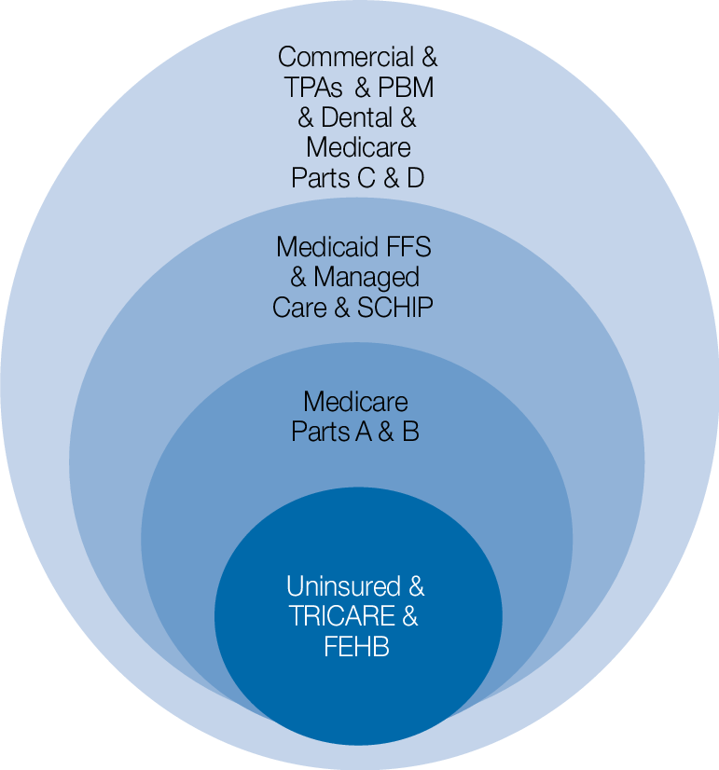
Which Payers Report to APCD?
Medicaid / Medicare → Nearly 100% Reporting
Commercial Insurance → Less than 50% Reporting
Requires inflation factors for population-level measures

Slide 6
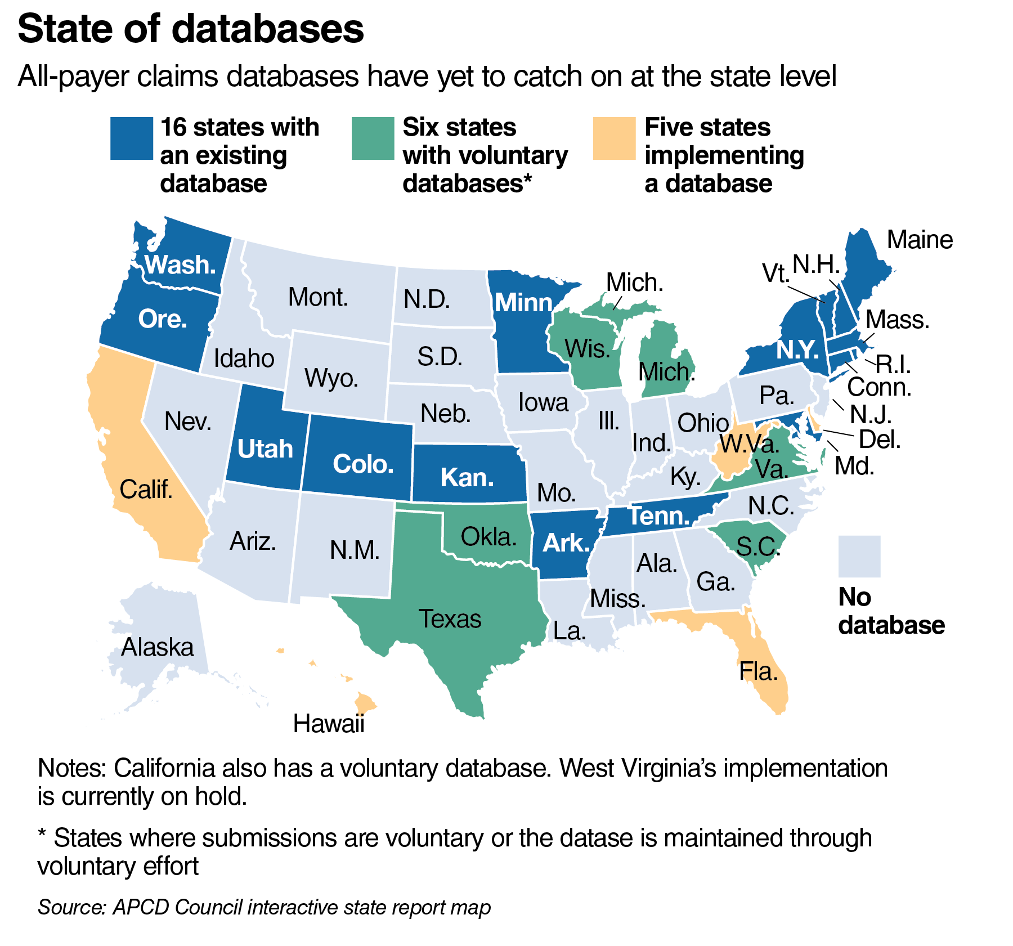

Slide 7
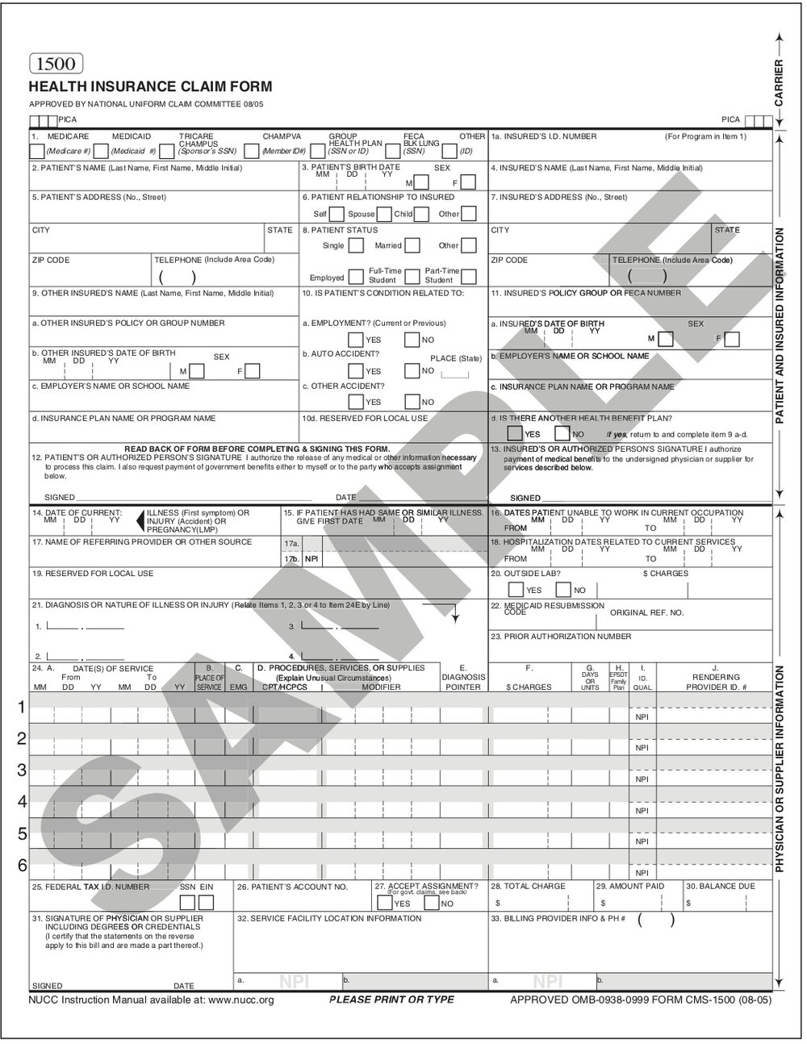
Where do Claims Databases Get Data?
Patient Information and Demographics
De-Identified
Provider Information
Care Information
Diagnoses
Procedures
Pharmaceuticals
What is NOT Included?
Patient Name/Address
Provider Name and Practice
Visit Type: Determined by Milliman

Slide 8
How Are Claims Databases Organized?

Slide 9

How we store APCD
Database is hosted on SQL server as a relational database
Self-Maintained
Self-Designed (following best practices)
Why a relational database?
There are a lot of data
Better scale/performance
Easier to capture the “big picture” -> join the pieces like a puzzle
Improve clinical phenotyping: claims data read as line items because they are used for payment; we are interested in entire clinical encounter
Could use other common data models (ex. OMOP, I2B2)
What is OMOP?
Observational Medical Outcomes Partnership created an informatic model designed for longitudinal observational databases (i.e. claims, EMR, registries)
Allows us to standardized and publicly-available vocabularies, queries and analytics
Promotes sharing and network studies

Slide 10
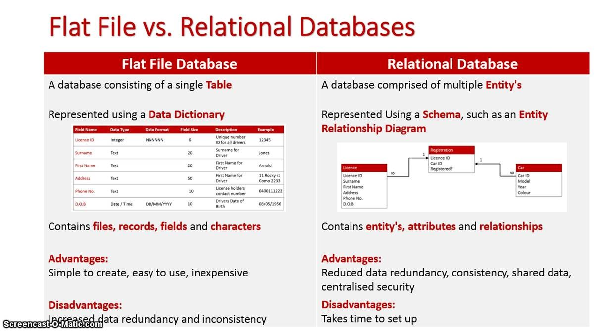

Slide 11
VA-APCD Relational Data Model Part I
Linked through Claim ID
Enrollment Table
Type of Medical Coverage (Private, Medicare, Medicaid)
Start and Stop Dates
Diagnosis Table
ICD Diagnosis Code (Up to 10)
Service/Billing NPI
Procedure Table
ICD Procedure Code (Up to 5)
Revenue Code
Service/Billing NPI
Visit Table
Unique Patient ID #
Unique Claim ID #
Date
Setting (Inpatient, Outpatient, ED)
Member Table
Unique Patient ID #
Patient Demographic and ZIP
Drug Table
NDC
Drug Name/Code
Therapeutic Class
Service/Billing NPI
Linked through Patient ID

Slide 12
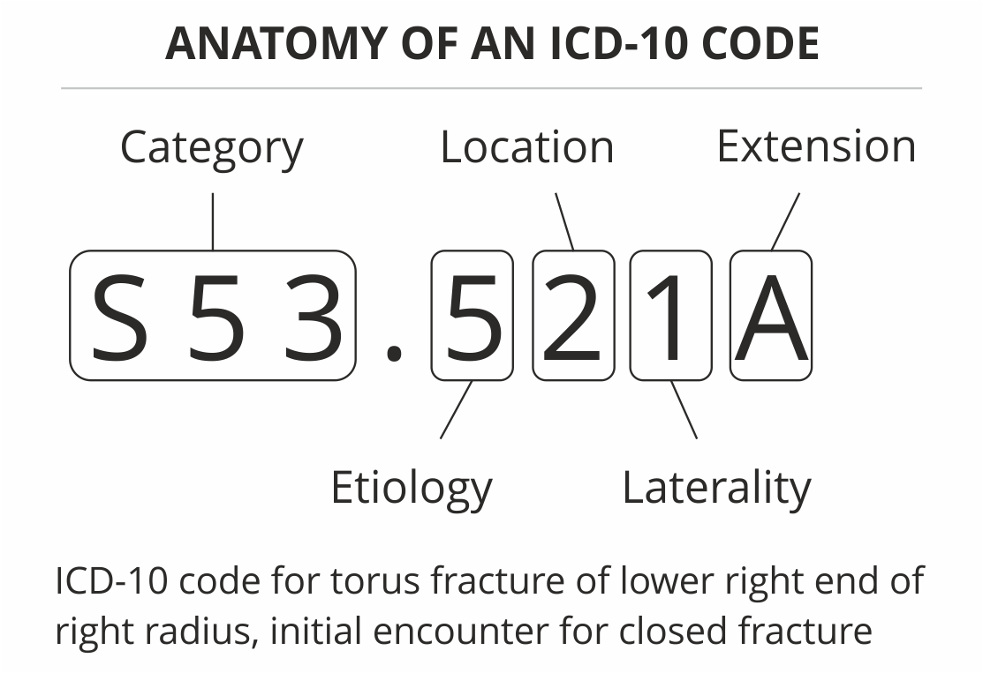
ICD Codes
Used for Diagnoses
Diagnoses often required for reimbursement for certain procedures

Slide 13
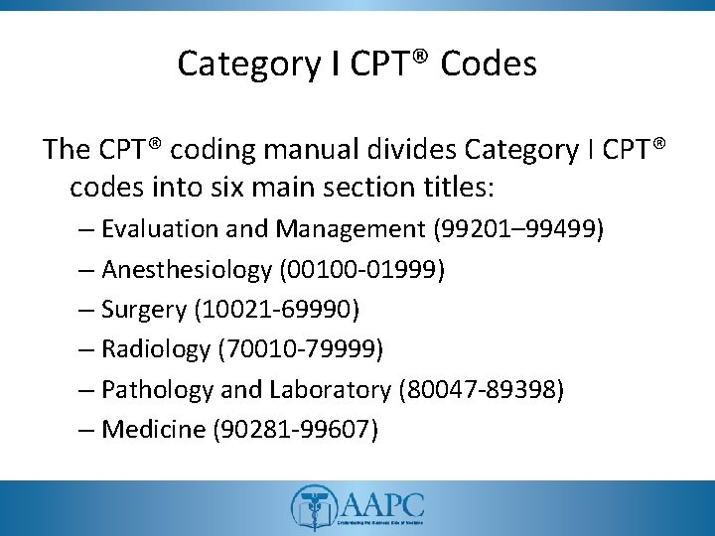
CPT Codes
Indicate particular medical procedures that are to be reimbursed by payers

Slide 14
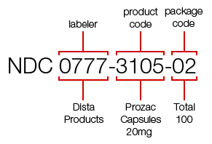
NDC Codes
Indicate prescriptions filled

Slide 15
Enforcement Activity
Use your new knowledge of the VA-APCD to address the following problems

Slide 16
Situation #1 Pediatric Bronchiolitis
Treatment for bronchiolitis (ICD-10: J21) in young children (less than 2 years) is often ineffective and unnecessary
We want to determine the percentage of children with bronchiolitis that receive unnecessary treatment, such as corticosteroids, beta-agonists or chest radiographs (CPT: 71045-71048, etc.)
What is appropriate cohort?
How do we “find” children belonging to cohort?
How do we determine if unnecessary treatment has been administered?

Slide 17
Situation #1 Pediatric Bronchiolitis
Steroids | PREDNISOLONE, | NDC - Drug Name
 | METHYLPREDNISOLONE, | NDC - Drug Name
 | METHYLPREDNISOLONE ACETAT, | NDC - Drug Name
 | METHYLPREDNISOLONE DOSE P, | NDC - Drug Name
 | PREDNISONE INTENSOL, | NDC - Drug Name
 | METHYLPREDNISOLONE SODIUM, | NDC - Drug Name
 | PREDNISOLONE, | NDC - Drug Name
 | PREDNISOLONE ANHYDROUS, | NDC - Drug Name
 | PREDNISOLONE SODIUM PHOSP, | NDC - Drug Name
 | DEXAMETHASONE, | NDC - Drug Name
 | DEXAMETHASONE 10-DAY DOSE, | NDC - Drug Name
 | DEXAMETHASONE 6-DAY DOSE, | NDC - Drug Name
 | DEXAMETHASONE INTENSOL, | NDC - Drug Name
 | DEXAMETHASONE SODIUM PHOS | NDC - Drug Name
Beta-agonists | ALBUTEROL SULFATE, | NDC - Drug Name
 | ALBUTEROL SULFATE ER, | NDC - Drug Name
 | ALBUTEROL SULFATE HFA, | NDC - Drug Name
 | LEVALBUTEROL, | NDC - Drug Name
 | LEVALBUTEROL HCL, | NDC - Drug Name
 | LEVALBUTEROL HYDROCHLORID, | NDC - Drug Name
 | LEVALBUTEROL TARTRATE HFA, | NDC - Drug Name
 | ALBUTEROL, | NDC - Drug Name
 | LEVALBUTEROL, | NDC - Drug Name
 | LEVALBUTEROL HCL, | NDC - Drug Name
 | LEVALBUTEROL HYDROCHLORID, | NDC - Drug Name
 | LEVALBUTEROL TARTRATE HFA | NDC - Drug Name
Chest Radiography | 71045 | Procedure Code (CPT)
 | 71046 | Procedure Code (CPT)
 | 71047 | Procedure Code (CPT)
 | 71048 | Procedure Code (CPT)
 | 71010 | Procedure Code (CPT)
 | 71015 | Procedure Code (CPT)
 | 71020 | Procedure Code (CPT)
 | 71021 | Procedure Code (CPT)
 | 71022 | Procedure Code (CPT)
 | 71023 | Procedure Code (CPT)
 | 71030 | Procedure Code (CPT)
 | 71035 | Procedure Code (CPT)

Slide 18
Situation #2 Neonatal Abstinence Syndrome
Neonatal abstinence syndrome (NAS) can occur with children born to drug-addicted mothers and can lead to developmental delays
We want to determine the percentage of children born with NAS who attend specialty care visits (social work, psychology, child protection, speech/language, occupational therapy)
What is appropriate cohort?
How do we “find” children belonging to cohort?
How do we determine if specialty care has occurred?

Slide 19
Situation #2 Neonatal Abstinence Syndrome
Measures | ICD9 | ICD10 | Description
Neonatal Opioid Exposure | 760.72 or 760.73 | P04.49 | Newborn affected by maternal use of other drugs of addiction
 | 779.5 | P96.1 | Neonatal withdrawal symptoms from maternal use of drugs of addiction
 | 292.0 or 304.00 | F11.23 | Opioid dependence with withdrawal
 | NA | P04.4 | Newborn affected by maternal use of drugs of addiction
 | 760.79 | P04.8 | Newborn affected by other maternal noxious substances
 | NA | P04.89 | Newborn affected by other maternal noxious substances
 | 304.00, 304.01 or 304.02 | F11.20 | Opioid dependence, uncomplicated
 | 304.10, 304.11 or 304.12 | F13.20 | Sedative, hypnotic or anxiolytic dependence, uncomplicated
 | NA | P04.14 | Newborn affected by maternal use of opiates
 | NA | P04.17 | Newborn affected by maternal use of sedative-hypnotics
 | 760.74 or 760.78 | P04.1 | Newborn affected by other maternal medication
 | 779.5 | P96.2 | Withdrawal symptoms from therapeutic use of drugs in newborn
 | CPT Code
Social Work or Psychology Visit | 90791
 | 90785
 | 90839
 | 90840
 | CPT Code
Child Protection Visit | 99201-99205
 | 99211-99215
 | CPT Code |  | Description
Speech/Language Visits | CPT 92506 |  | EVALUATION OF SPEECH, LANGUAGE, VOICE, COMMUNICATION, AND/OR AUDITORY PROCESSING
 | CPT 92508 |  | GROUP, 2 OR MORE INDIVIDUALS: TREATMENT OF EVALUATION OF SPEECH, LANGUAGE, VOICE COMMUNICATION AND/OR AUDITORY PROCESSING DISORDER
 | CPT 92521 |  | EVALUATION OF SPEECH FLUENCY (E.G., STUTTERING)
 | CPT 92523 |  | EVALUATION OF SPEECH SOUND PRODUCTION WITH EVALUATION OF LANGUAGE COMPREHENSION AND EXPRESSIONS
 | CPT 92524 |  | BEHAVIORAL AND QUALITATIVE ANALYSIS OF VOICE AND RESONANCE
 | CPT 92522 |  | EVALUATION OF SPEECH SOUND PRODUCTION
 | CPT 92507 |  | TREATMENT OF EVALUATION OF SPEECH, LANGUAGE, VOICE COMMUNICATION AND/OR AUDITORY PROCESSING DISORDER
 | CPT 92526 |  | ORAL FUNCTION THERAPY (FEEDING CODE)
 | CPT Code |  | Description
Occupational Therapy Visits | CPT 97110 |  | THERAPEUTIC EXERCISES
 | CPT 97129 |  | THERAPEUTIC INTERVENTIONS THAT FOCUS ON COGNITIVE FUNCTION AND COMPENSATORY STRATEGIES
 | CPT 97130 |  | THERAPEUTIC INTERVENTIONS THAT FOCUS ON COGNITIVE FUNCTION AND COMPENSATORY STRATEGIES ; EACH ADDITIONAL 15 MIN
 | CPT 97139 |  | UNLISTED THERAPEUTIC PROCEDURE (SPECIFY)
 | CPT Code |  | Description
Physical Therapy Visits | CPT 97150 |  | PHYSICAL MEDICINE AND REHAB THERAPEUTIC PROCEDURES
 | CPT 97161 |  | PT EVAL, LOW COMPLEXITY
 | CPT 97162 |  | PT EVAL, MODERATE COMPLEXITY
 | CPT 97163 |  | PT EVAL, HIGH COMPLEXITY

